Slide 1
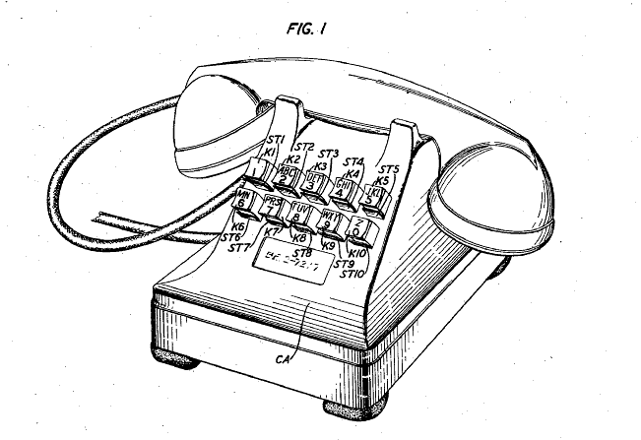
This the original design of the push button telephone
How are modern phones different?
Source: http://www.google.com/patents/US2394926?dq=2,394,926

